Slide 1

Goulcrest
Health Center
mindful
meditation
An interactive seminar on using meditation to combat anxiety and depression
created by
Aditya Lokhande

Slide 2

Mindfulness and Meditation in Student Life
📚🧘‍♀️
Stay Calm,
Focus Better,
Live Happier

Slide 3

What is Mindfulness?
Mindfulness means being fully present in the moment.
Paying attention to thoughts, feelings, and surroundings without judgment.
Helps us stay calm and focused.

Slide 4

What is Meditation?
Meditation is a mental exercise where we focus on breath, sound, or a word.
It helps in relaxing the mind and reducing stress.
Just a few minutes daily can bring big changes.

Slide 5

Why Students Need It ?
Students face:
Exam pressure 😓
Distractions 📱
Lack of sleep 😴
Emotional stress 😡😢
Mindfulness and meditation can helps to manage all these.

Slide 6

Benefits for Students
✅ Reduces stress and anxiety.
✅ Improves focus and memory .
✅ Helps better sleep .
✅ Builds self-confidence .
✅ Improves mood and patience.

Slide 7
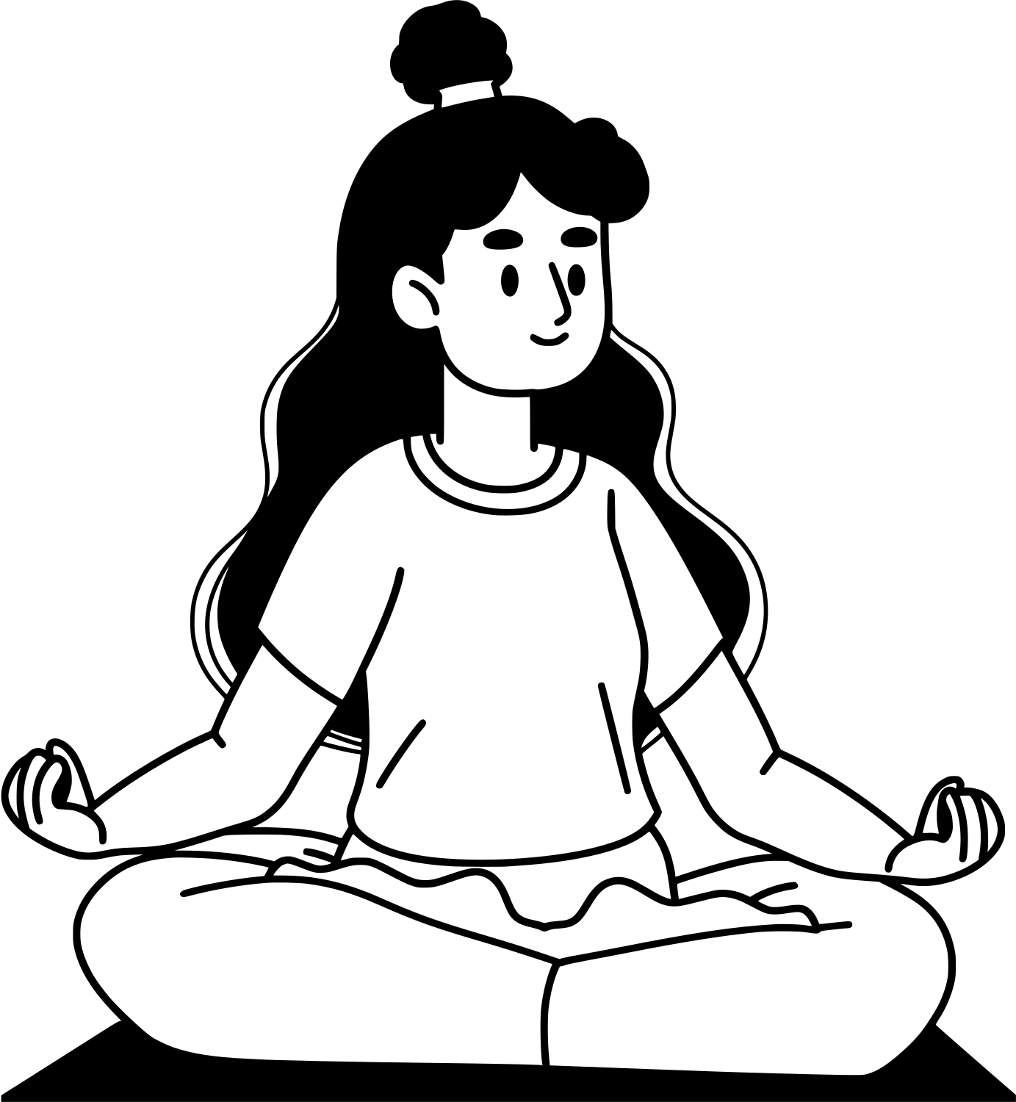
Simple Ways to Practice
Deep Breathing – Inhale slowly, exhale slowly.
5-Minute Meditation – Sit quietly and focus on your breath.
Mindful Walking – Walk slowly and feel each step .
Gratitude Practice – Think of 3 things you’re thankful for every day.

Slide 8


